Slide 1
Abstract factory pattern
Abstract Factory patterns work around a super-factory which creates other factories.
This factory is also called as factory of factories. In Abstract Factory pattern an interface is responsible for creating a factory of related objects without explicitly specifying their classes.
Each generated factory can give the objects as per the Factory pattern.

Slide 2
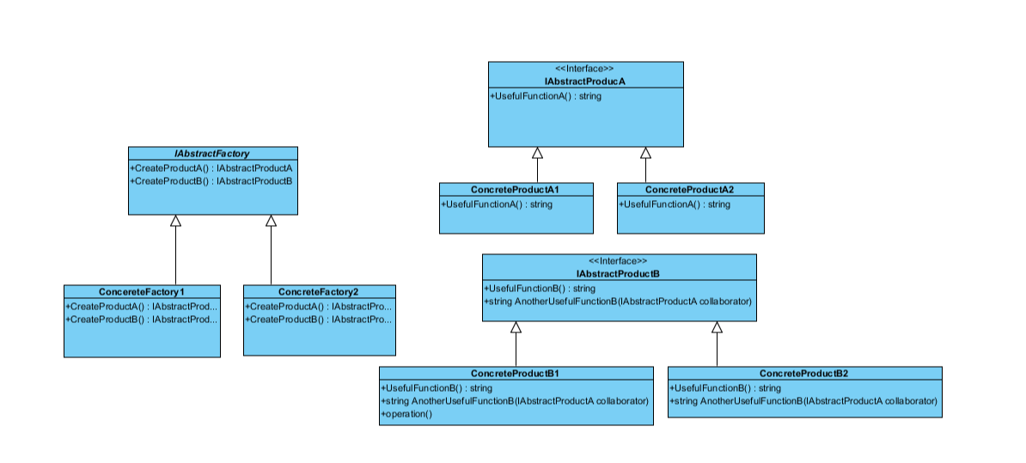

Slide 3
Thanks for watching

